Slide 1
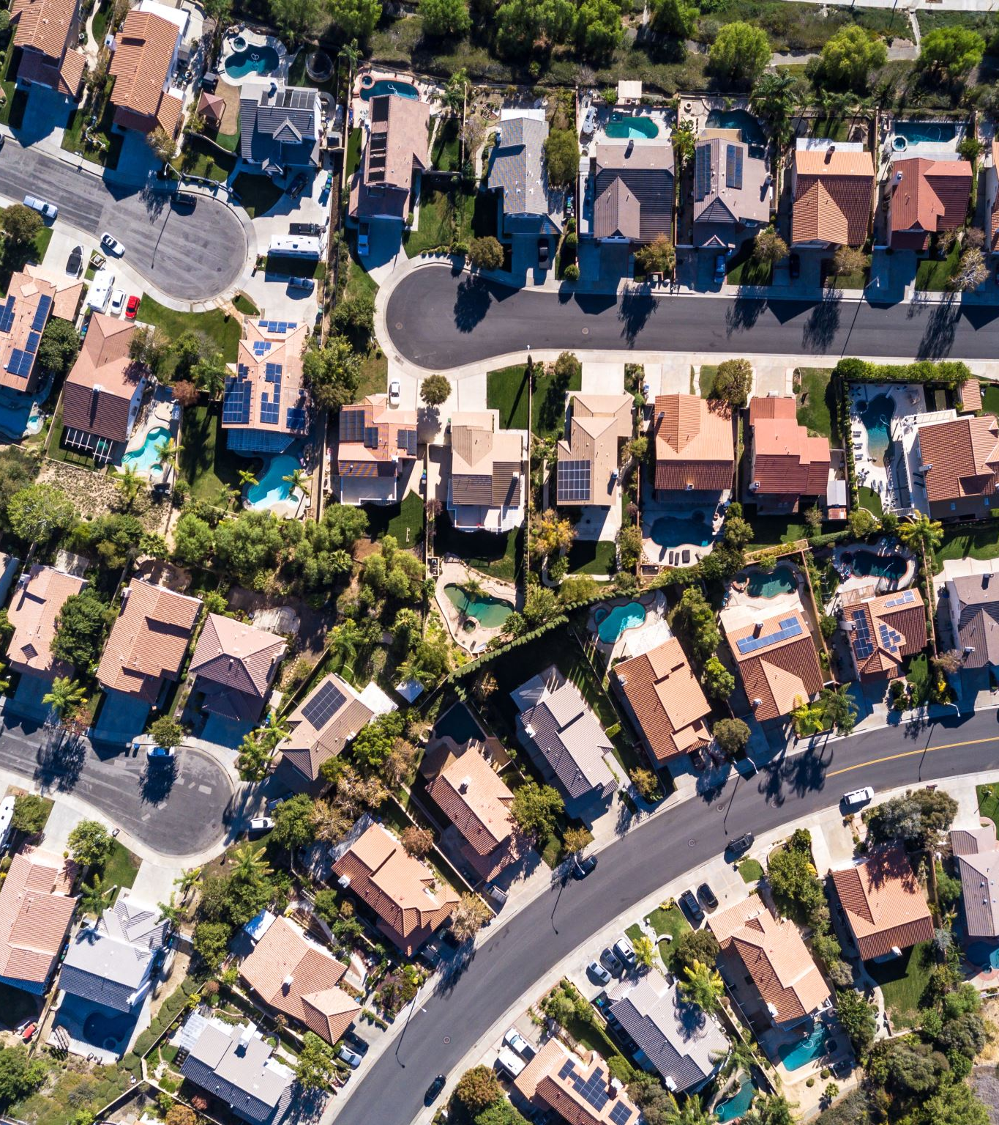
PYTHON CRN 22146 California Housing 1990 – Analysis & Predictions
By:
Shubham Mittal
Swayambhu dhuri
Akshat ulhas shanbhag

Slide 2
Abstract
Our project explores predictive models for California Housing 1990 dataset, employing Linear Regression, Random Forest, Decision Tree, and Support Vector Regression. Through comprehensive analysis and comparison, we assess the efficacy of these models in predicting housing median values. Additionally, exploratory data analysis (EDA) enhances our understanding of the dataset's characteristics and relationships. Our findings shed light on the most suitable model for predicting housing values in diverse Californian locales, offering valuable insights for housing market stakeholders and researchers alike.

Slide 3

Introduction
The California Housing 1990 dataset provides insights into the housing-related information, offering insights into factors influencing housing values in California during 90s.
In this study, we delve into the dataset's intricacies, evaluating various predictive models to find patterns and make informed predictions.
Our analysis focuses on Linear Regression, Random Forest, Decision Tree, and Support Vector Regression techniques, evaluating their results in forecasting median house values.
Moreover, through exploratory data analysis (EDA), we will explore the dataset's underlying trends and relationships.

Slide 4
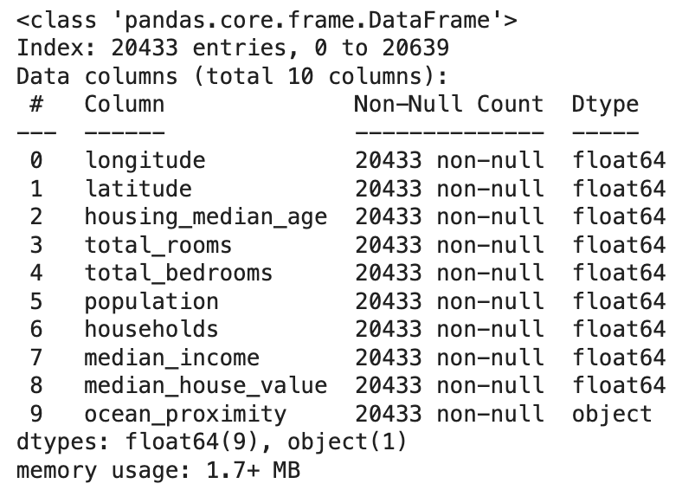
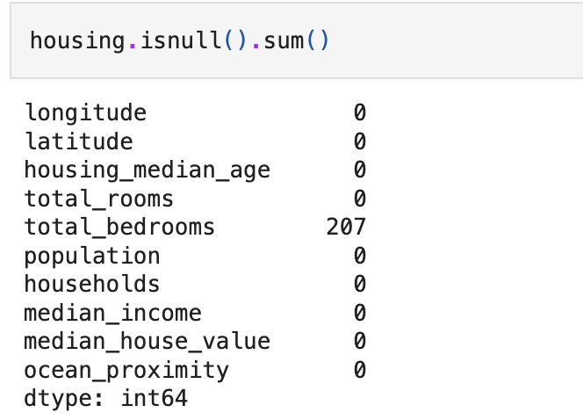
Dataset
There are 20,640 entries in the database.
Column Details:
longitude: Longitude coordinate of the location.
latitude: Latitude coordinate of the location.
housing_median_age: Median age of the housing in the location.
total_rooms: Total number of rooms in the housing.
total_bedrooms: Total number of bedrooms in the housing.
population: Total population in the housing area.
households: Total number of households in the housing.
median_income: Median income of households in the housing area.
median_house_value: Median value of houses in the housing area.
ocean_proximity: Proximity of the housing area to the ocean.
The 1990 California Housing dataset illuminates economic trends via housing factors, offering insights into growth, decline, and market dynamics.
Figure 1: data information
Figure 2: NULL values in dataset

Slide 5
Preprocessing
Handling null values: checked for null values within the dataset. Dropped any null values present in the dataset.
Dividing the dataset into the training and testing dataset.
Data exploration: explored the dataset to understand its structure, contents, and any potential patterns. Identified relevant features and variables for further analysis and visualization.

Slide 6

Data Visualization Exploratory Data Analysis

Slide 7
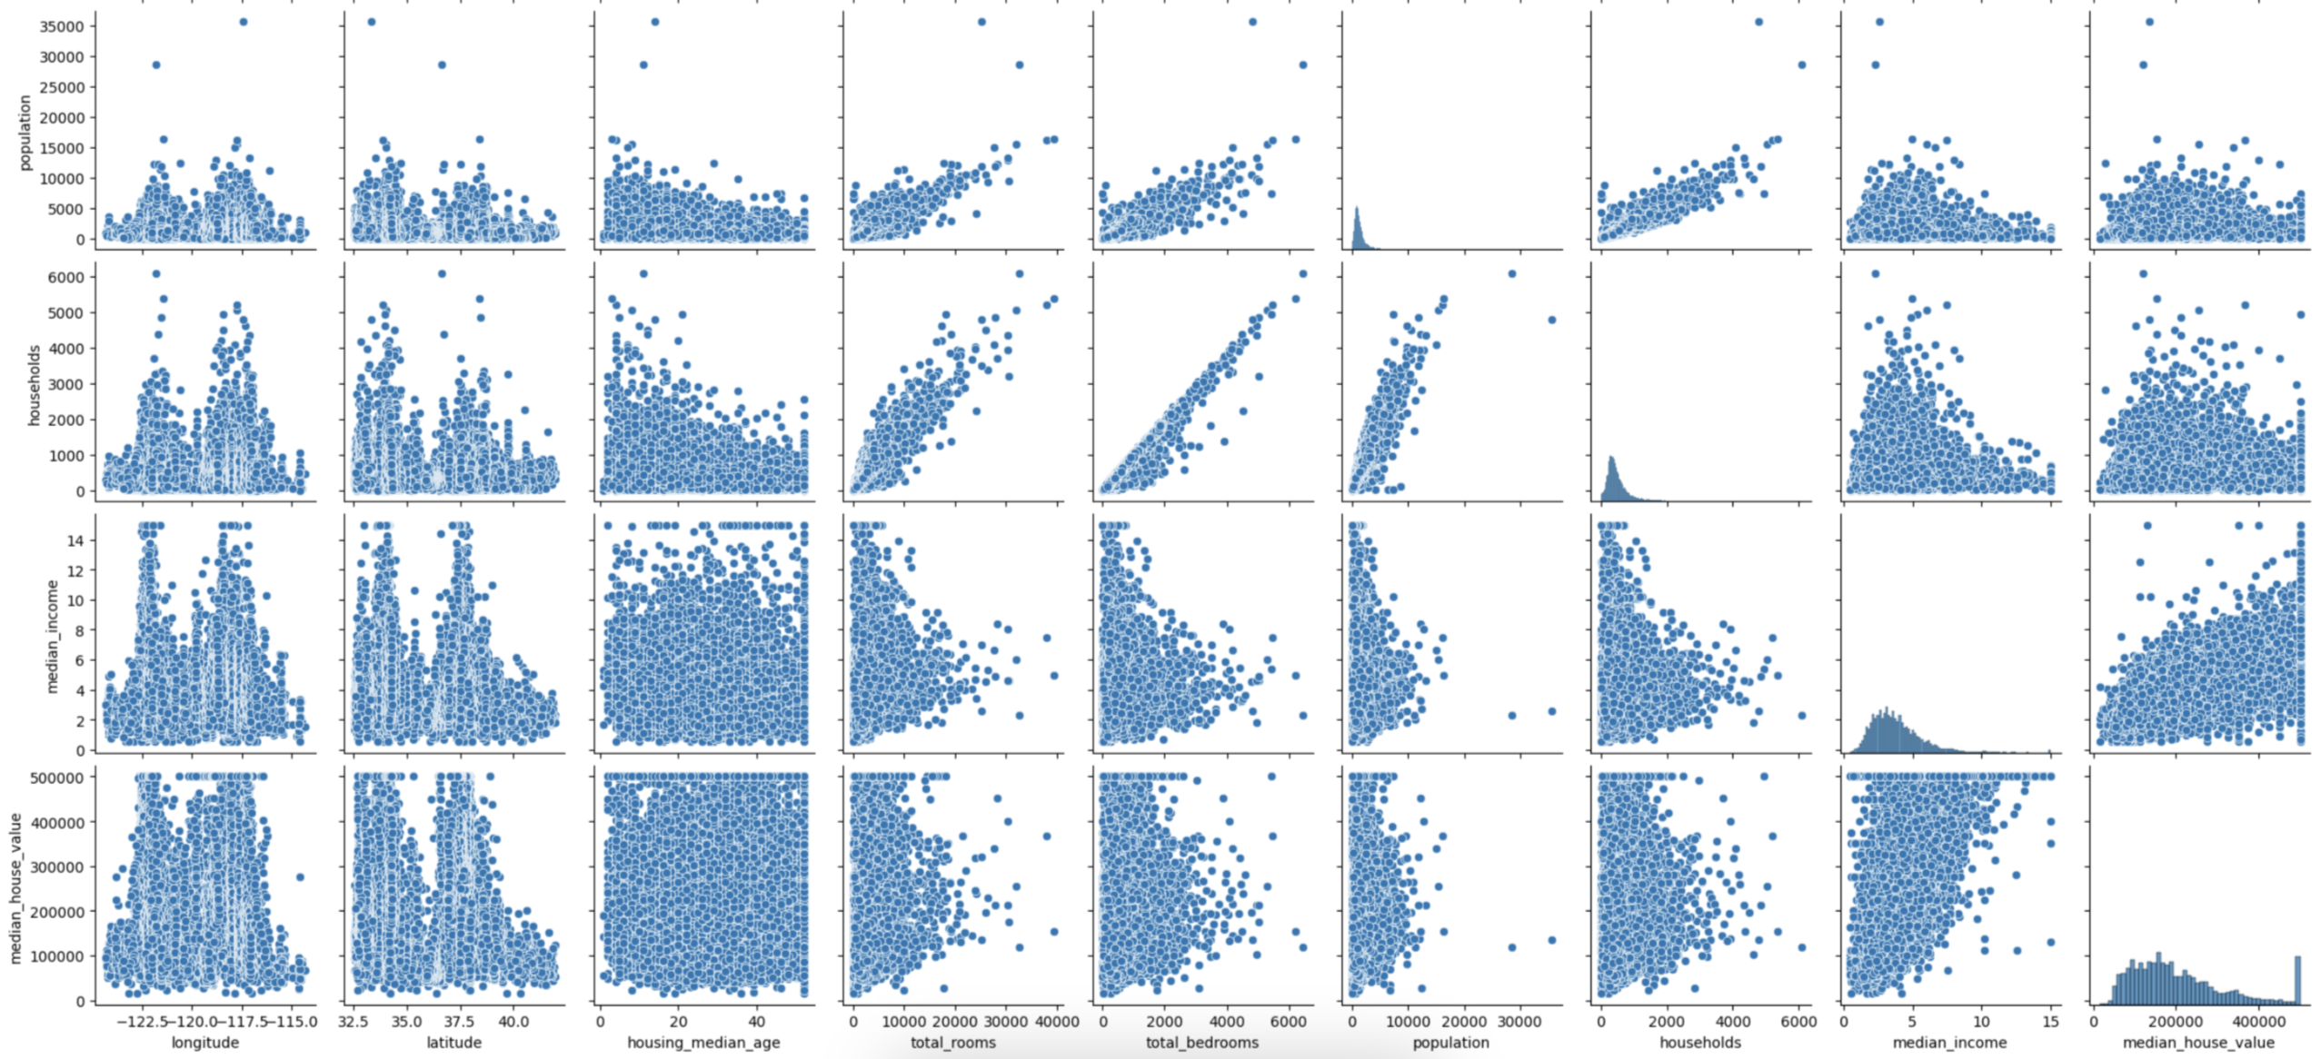
Figure 3: Pair-plot

Slide 8
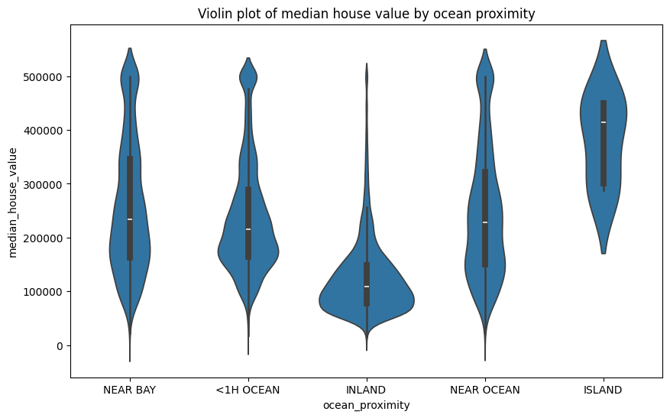
Figure 4: Violin Plot - suggests that properties closer to the ocean, such as those in the "ISLAND" and "NEAR OCEAN" categories, tend to have higher median house values compared to those further inland.

Slide 9
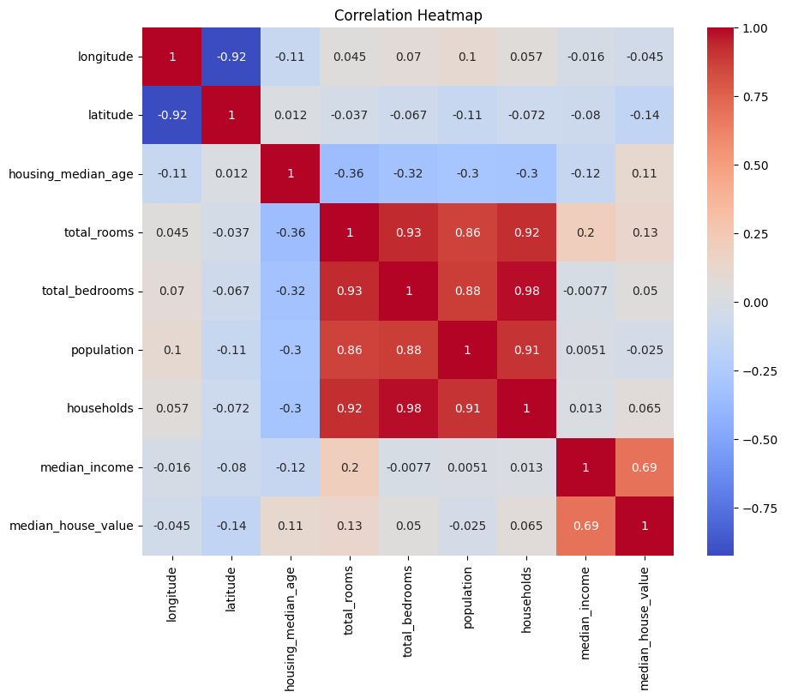
Figure 5: Colors indicate how closely features are related. Red means they tend to go up together, blue means they tend to go in opposite directions, and white means there's no clear connection.

Slide 10
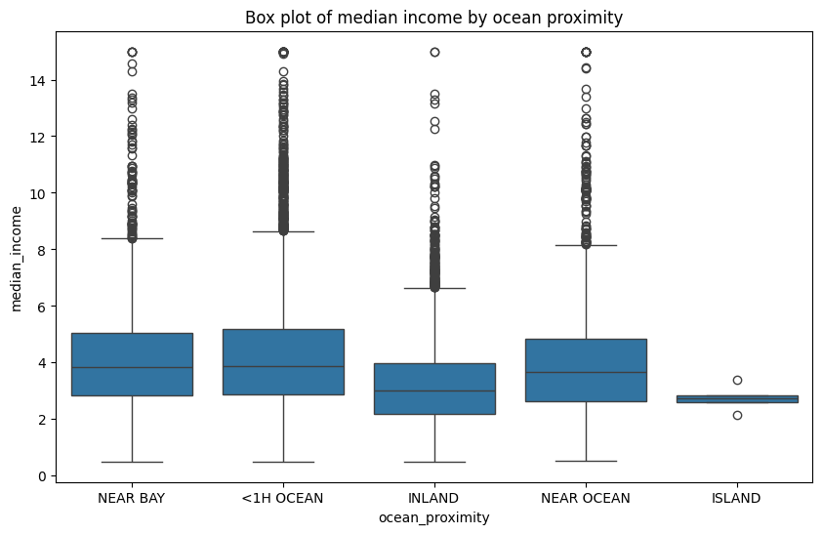
Figure 6: The boxes reveal a wider spread of incomes for houses closer to the ocean, whereas inland areas tend to have a tighter range of incomes.

Slide 11
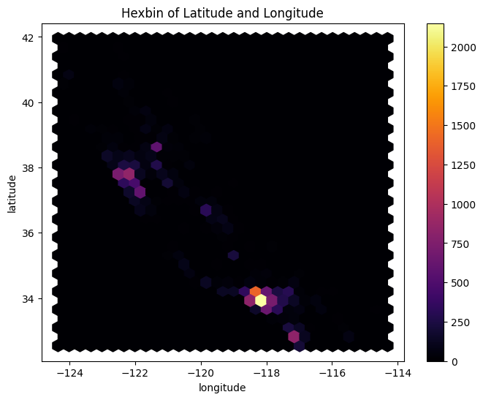
Figure 7: We can see that houses are not spread uniformly across California, but rather there are clusters of houses in certain areas.

Slide 12
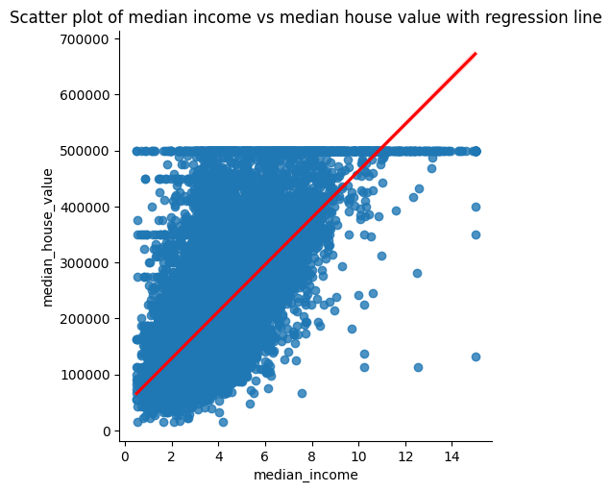
Figure 8: this scatter plot shows the relationship between median income and median house value in California.

Slide 13
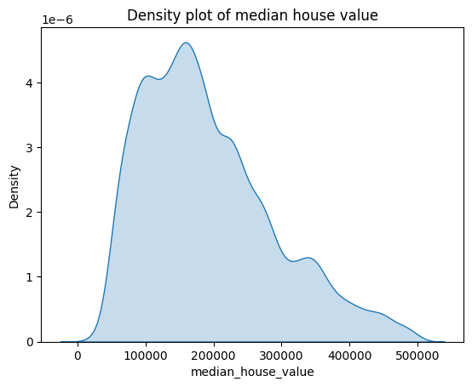
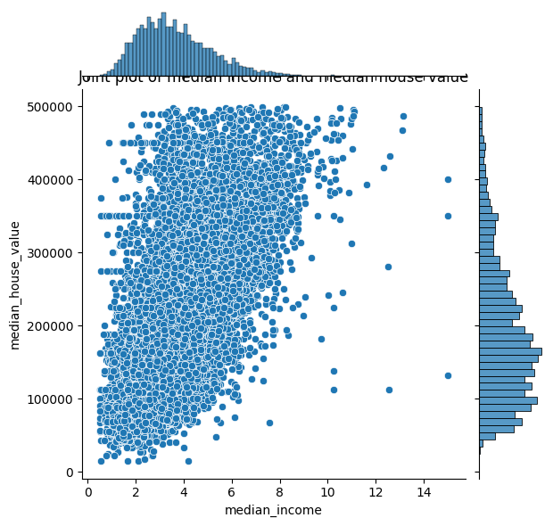
Figure 9: the distribution of median house values in this price range using this density plot.
Figure 10: joint plot shows the relationship between median income and median house value in California.

Slide 14
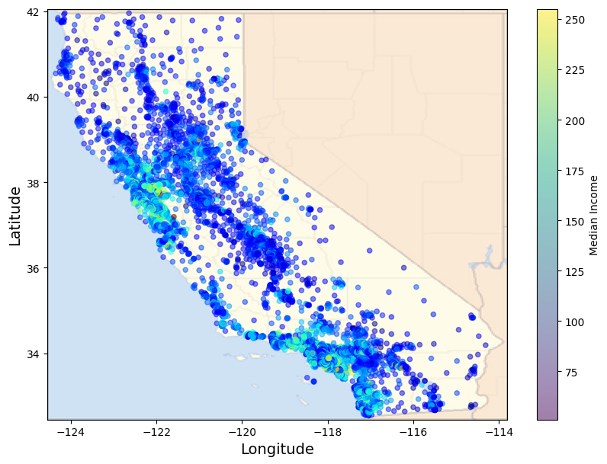
Figure 11: the geographic distribution of houses in our California housing dataset, overlaid on a map.

Slide 15
Analysis Summary
Many features exhibit non-linear relationships with the target variable.
There is a noticeable correlation between "total_bedrooms" and "households," suggesting possible duplication of information.
"Total_rooms," "total_bedrooms," and "population" are closely related and demonstrate correlation with each other.
"Median_income" shows a clear linear relationship with the target variable.
"Latitude" and "longitude" do not show linear relationships with the target, but the majority of data points cluster around two specific locations, indicating potentially highly populated areas.
Suspected outliers are observed:
"Housing_median_age" ranges from 0 to 52, with a significant concentration at 52 (>1000 records).
"Population" feature indicates an outlier that affects the plot.
"Total_rooms" and "median_income" have a slight possibility of outlier data points.

Slide 16
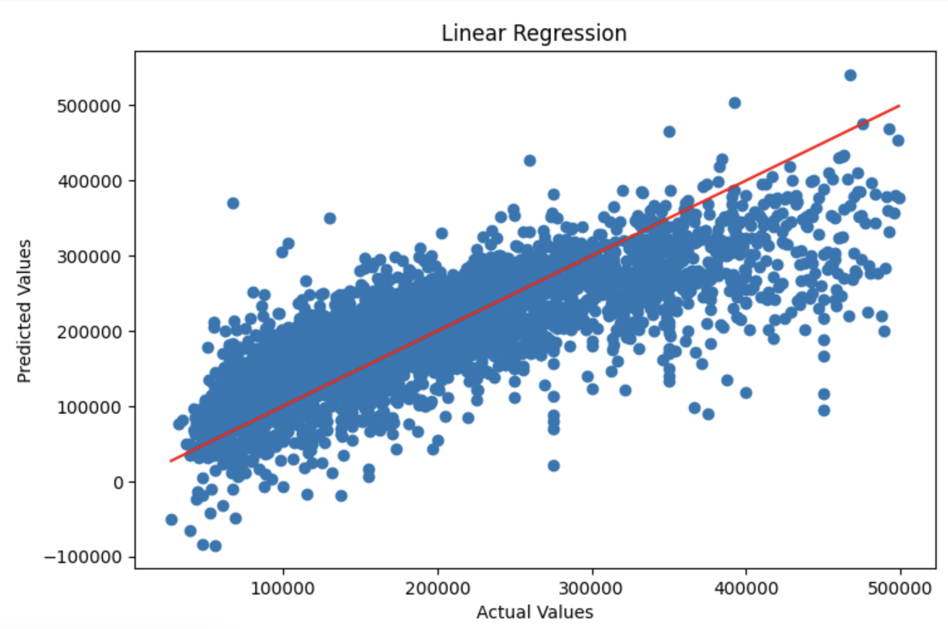
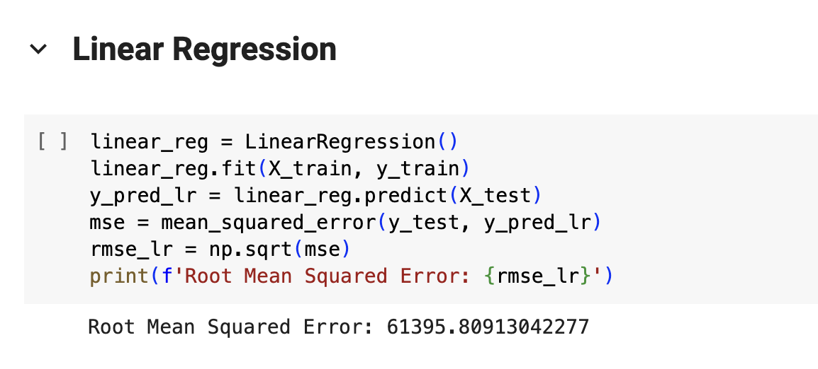
Linear Regression

Slide 17
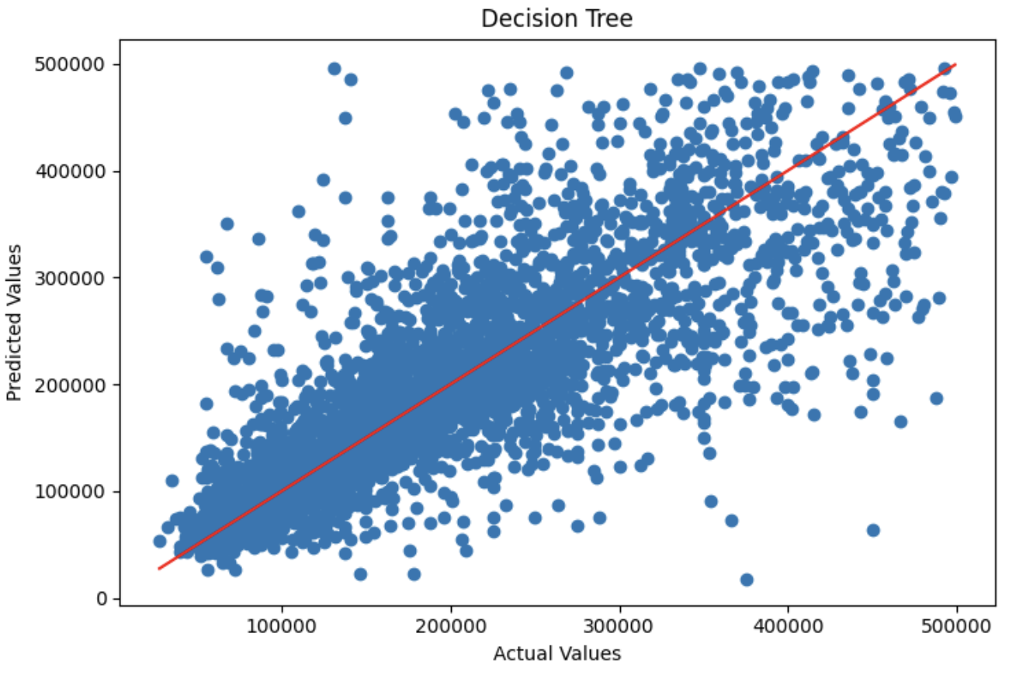
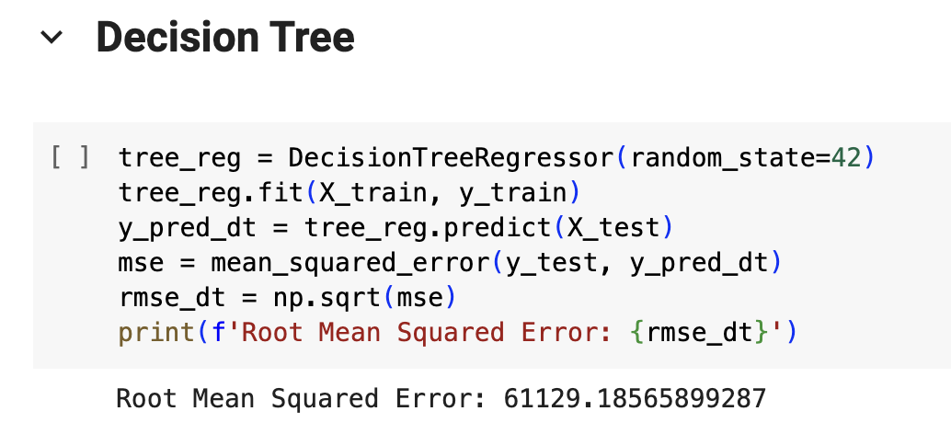
Decision Tree

Slide 18
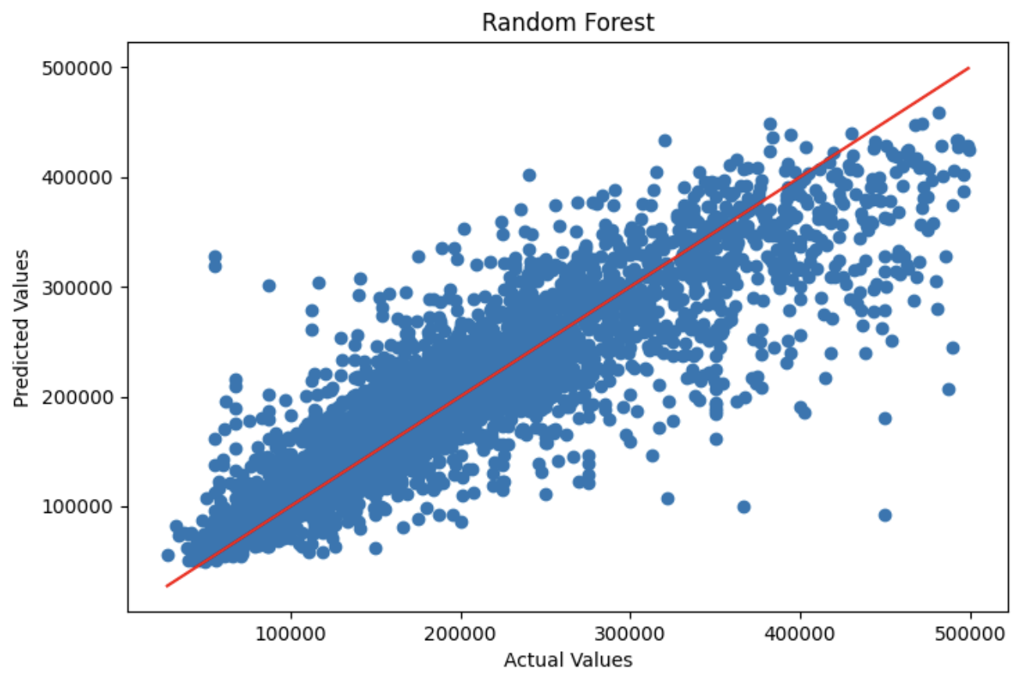
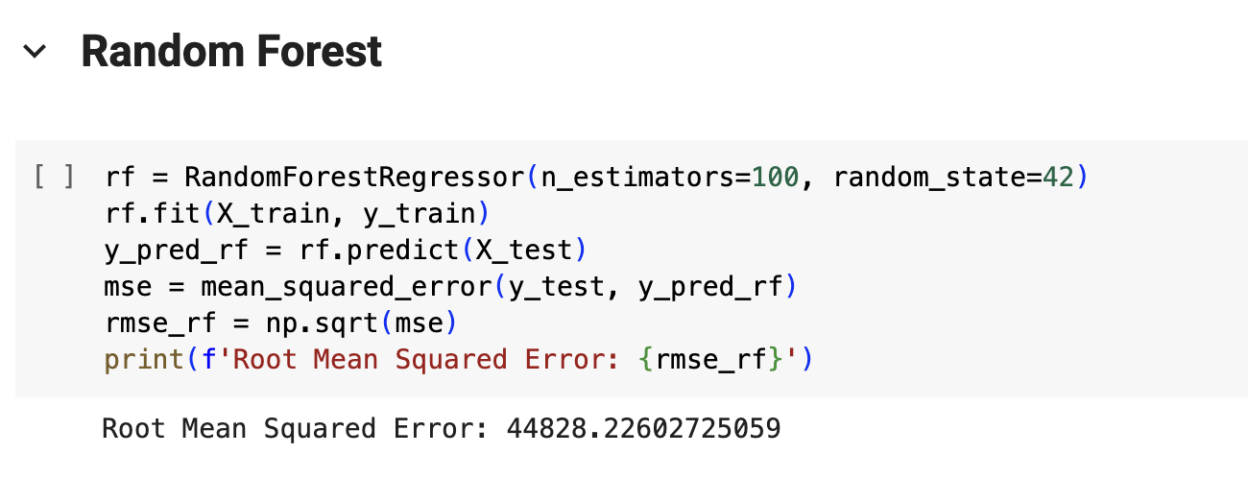
Random Forest

Slide 19
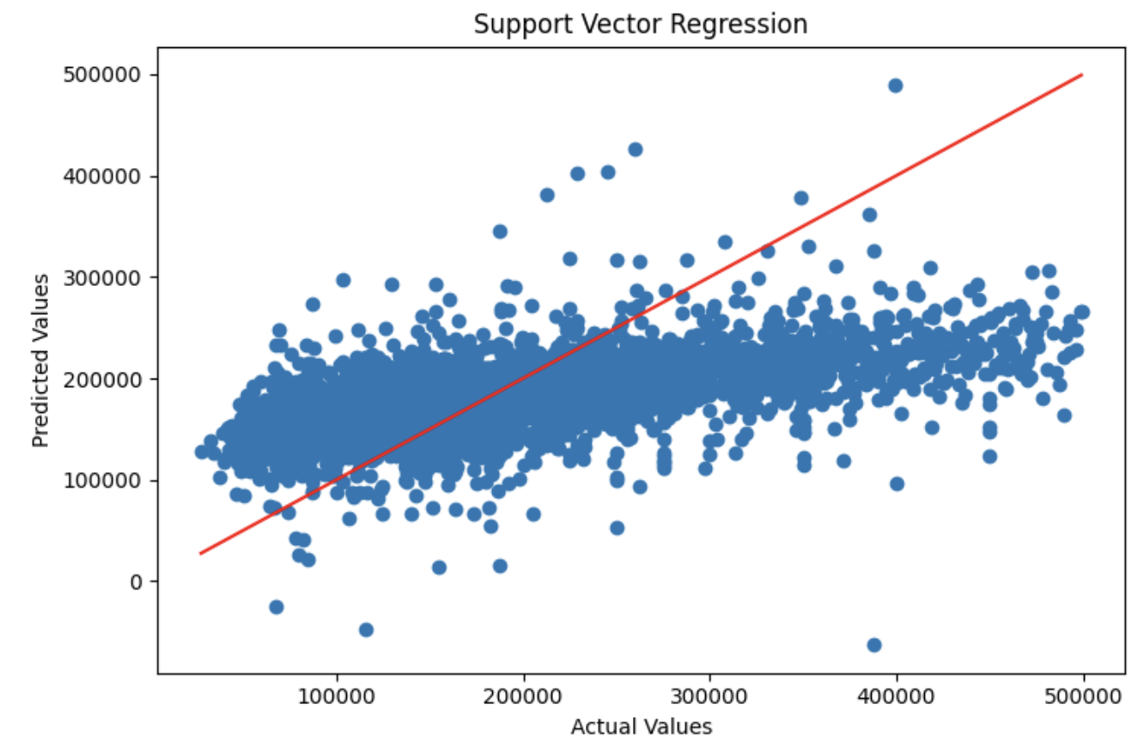
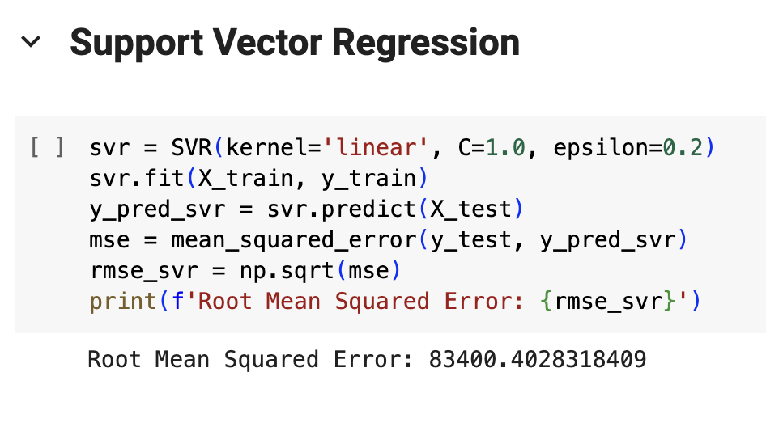
Support Vector Regression

Slide 20
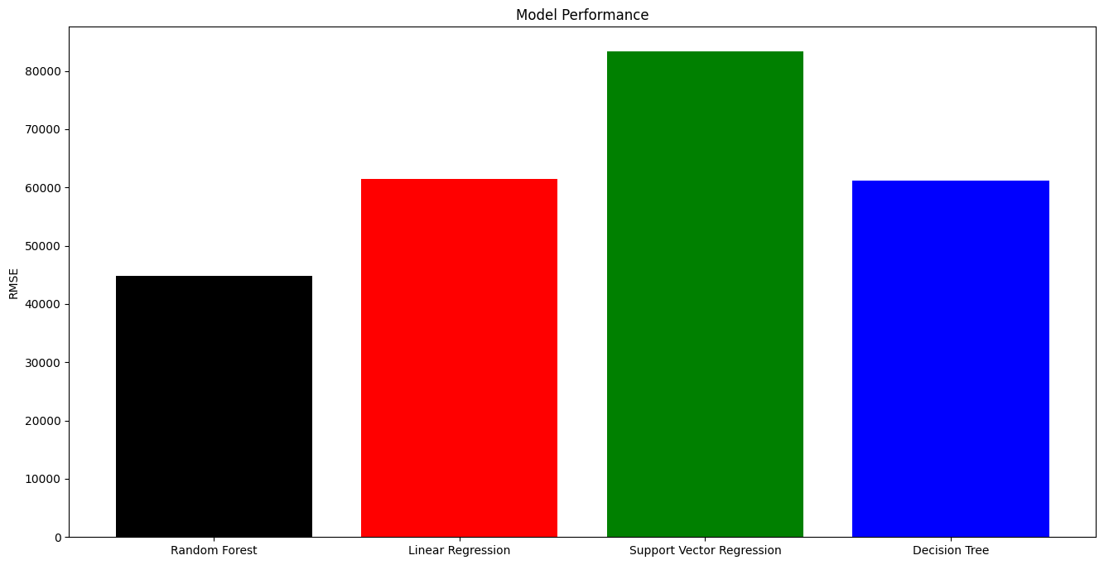
Conclusion
The Random Forest model has the lowest RMSE (44828.2260), making it the best-performing model.
Random Forest is a powerful ensemble learning method that builds multiple decision trees and merges their predictions to improve accuracy and reduce overfitting.

Slide 21
Future Scope
Feature Engineering: Analyze and preprocessing features to extract more meaningful information. This could involve creating new features, scaling features, handling missing values, or transforming variables.
Hyperparameter Tuning: Adjust the hyperparameters of the models to find better combinations that improve performance.
Ensemble Methods: Implement ensemble techniques such as bagging, boosting, or stacking to combine multiple models for improved performance.
Cross-Validation: Ensure robust evaluation of models by using cross-validation techniques to estimate performance on unseen data more accurately. This helps in identifying overfitting and ensures that model generalizes well to new data.
Feature Selection: Identify and select the most relevant features for prediction, which can help in reducing model complexity and overfitting. Techniques like feature importance from Random Forest or Lasso regularization in linear regression can aid in feature selection.

Slide 22

Why not Logistic Regression?
Logistic regression is a binary classification algorithm, commonly used when the dependent variable is binary. However, the Data provided contains data for predicting housing prices (median_house_value), which is a continuous variable, not a binary one.
Still, we can implement the Logistic Regression by Feature Engineering and implementing Logistic Regression to predict values which higher and lower at a threshold point. But this will result in poor performance of the model.

Slide 23
References
https://github.com/swayambhu/python-final-presentation
https://www.kaggle.com/datasets/camnugent/california-housing-prices

Slide 24
Thank You

